Slide 1


Tutorial: Machine Learning in Magnetism
Basic introduction to Machine Learning
in a physical context
Silvia Vock

Slide 2



Load examples before start (note: google account needed for download and testing without: only reading possible or use possibility from next slide):
Example 1
https://colab.research.google.com/drive/1rWAgBrCHUqHVu0tnWBRBv1zMTpBua24O?usp=sharing
Example 2
https://colab.research.google.com/drive/1AhMcnc1UgxsW1BAa4qe53UTGBCJFKpis?usp=sharing
Example 3
https://colab.research.google.com/drive/1XV0F6JqiU2gR5b_J_Y5M6TYlA184m4ts?usp=sharing
Scan with mobile and send link to your own email-account for use on laptop!

Slide 3


Download exercises and presentation:
https://github.com/SilviaVock/IEEE-MMM-2023-Hands-on-tutorial

Slide 4

Without google account try this (probably very slow…):
https://github.com/SilviaVock/IEEE-MMM-2023-Hands-on-tutorial
click

Slide 5



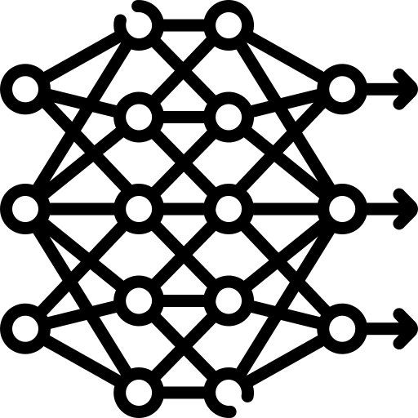


Content
Machine Learning – Overview and Basic Understanding
Hands - On 1: Simple workflow for a classification task
2. The heart of Machine Learning: Fitting a Regression
3. Focus: Neural Networks
Hands - On 2: Linear regression from scratch
Hands - On 3: Training and evaluating a DNN
4. Short Excursion: Dependable Machine Learning
5. Short Excursion: Physics - Informed Deep Learning

Slide 6
Content
Machine Learning – Overview and Basic Understanding
Hands - On 1: Simple workflow for a classification task

Slide 7


ML principle: Data driven knowledge discovery
measurement data
algorithm
answer to research question
Machine Learning
program modules with adjustable elements that are autonomously tuned in a learning process
static program codes

Slide 8
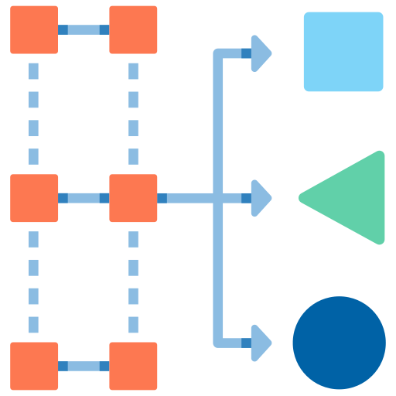
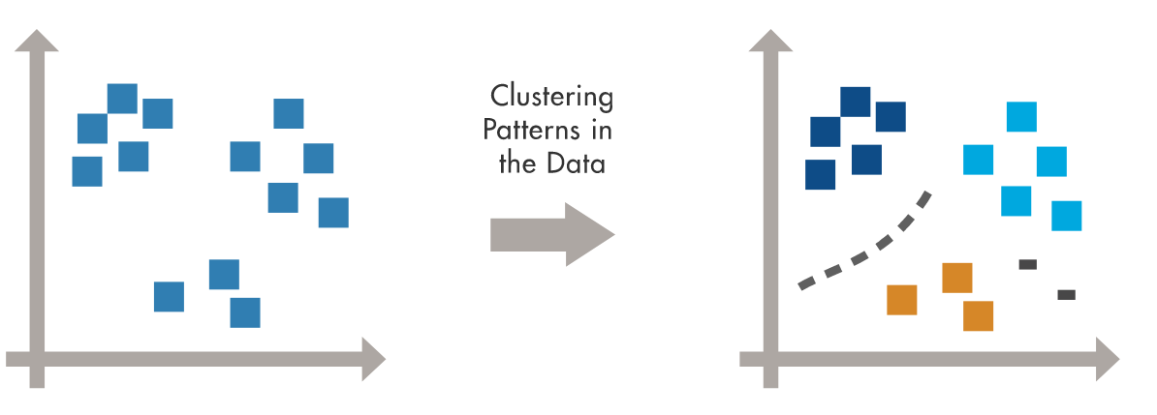
Basic Machine Learning paradigms
Labeled Data
Direct Feedback
Predict outcome/future
Supervised Learning
No labels
No feedback
Find hidden structure in data
Unsupervised Learning
Reward
Decision process
Reward system
Learn series of actions
environment
Reinforcement Learning
State
Action
agent
Raschka, Mirjalili, Python Machine Learning, Packt 2019

Slide 9
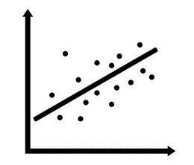
Basic Machine Learning paradigms
Labeled Data
Direct Feedback
Predict outcome/future
Supervised Learning
classification
regression
Raschka, Mirjalili, Python Machine Learning, Packt 2019
Notes:
can be defined as win or lose at the end of the game.

Slide 10
Machine Learning – Basic Workflow
alternative evaluation methods:
simulations
manually with expert knowledge
additional measurements
classical algorithms
…
Labels
Training Data
Machine Learning Algorithm
New Data
Predictive Model
Prediction
Raschka, Mirjalili, Python Machine Learning, Packt 2019

Slide 11
Data types
tabular
graphs
signals
sequences
Static
tabular data
Time
series
Event streams
social
networks
physical networks
images
audio
video
Natural language
Bio- logical se-quences
Software source code
Varsheney, Trustworthy Machine Learning, independently published 2022

Slide 12
Machine Learning Examples in physics research

Slide 13
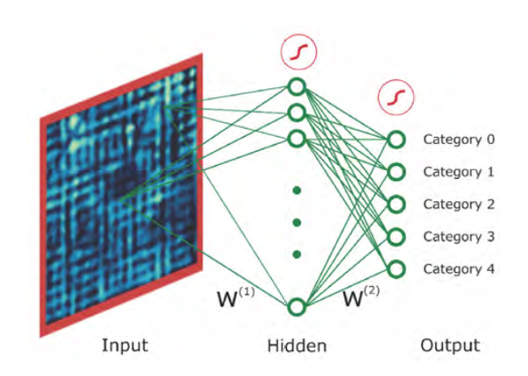
Data and tasks in physics research: STM image classification
Carleo et al., Machine learning and the physical sciences,10.1103/RevModPhys.91.045002,2019
Data:
STM images of superconductors
Task:
classification according to distinct types of spatial modulations

Slide 14
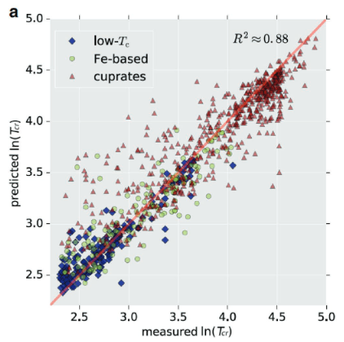
Data and tasks in physics research: Predicting T_{cr} of superconductors
Chen, Chi, et al. "A critical review of machine learning of energy materials." Advanced Energy Materials 10.8 2020
Data:
material data bases (e.g. SuperCon) extended by non-superconducting materials
and structural information (lattice parameters, band structure,…)
Task:
predicting T_{cr}

Slide 15
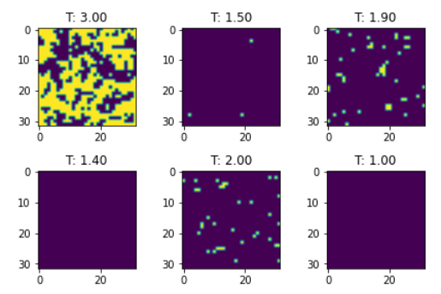
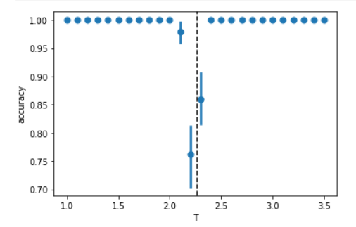
Data and tasks in physics research: Magnetic phases
https://nbviewer.org/github/DeepLearningForPhysicsResearchBook/deep-learning-physics/blob/main/Exercise_08_1_solution.ipynb
Data:
MC simulation of magentic dipole moments on square lattice at given temperature T
Task:
classification of magnetic phases (pm/fm)
prediction of T_{c}

Slide 16
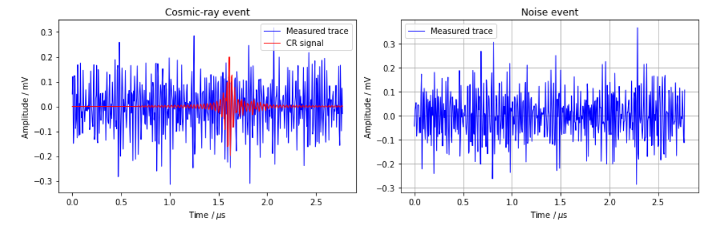
Data and tasks in physics research: Signal identification
https://nbviewer.org/github/DeepLearningForPhysicsResearchBook/deep-learning-physics/blob/main/Exercise_09_2_solution.ipynb
Data:
Time series of electromagnetic radiation generated in the atmosphere
Task:
identification of cosmic-ray events in signal traces with a high SNR

Slide 17

Quick start: steps of training a classification model with scikit-learn
#import data
df = read_csv(‘https://‘, delimiter = ,)
#extract input and output
X =
Y =
#split
X_train, X_test, Y_train, Y_test = train_test_split(X,Y,…)
#build model
model = model.fit()
#evaluate model
model.score(X_test, Y_test)
#use model for prediction
Y_predict = model.predict(X_test)

Slide 18
Quick start without theory CODING EXAMPLE 1: Simple MNIST classifier

Slide 19
Content
Machine Learning – Overview and Basic Understanding
The heart of Machine Learning: Fitting a Regression
Focus: Neural Networks
Short Excursion: Dependable Machine Learning
Short Excursion: Physics - Informed Deep Learning
Hands - On 1: Simple workflow for a classification task
Hands - On 2: Linear regression from scratch
Hands - On 3: Training and evaluating a DNN

Slide 20
Content
2. The heart of Machine Learning: Fitting a Regression
Hands - On 2: Linear regression from scratch

Slide 21
The heart of a Neural Network
Thomas Nield, Basic Math for Data Science, O‘Reilly 2022, p. 157
Machine Learning is Fitting a Regression
This is the heart of „training“ a machine learning algorithm. We provide some data and an objective function (the sum of squares) and it will find the right coefficients m and b to fullfill that objective. So when we „train“ a machine learning model we really are minimizing a loss function.
Content of 2nd part:
Basics of linear regression
Content of 3rd part:
How does this translates into neural networks?

Slide 22
CODING EXAMPLE 2: Regression from scratch

Slide 23
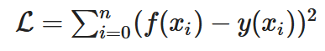
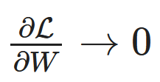
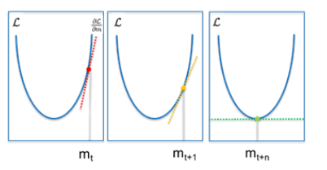
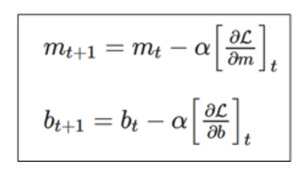
Summary of important terms
loss function, objective function, cost function
learning: minimizing loss
minimizing loss: Gradient descent
learning rate

Slide 24
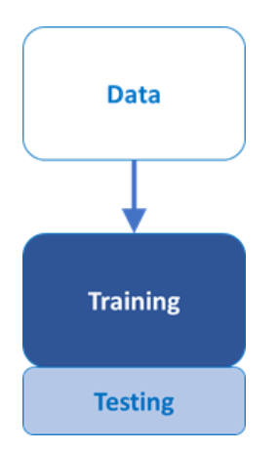
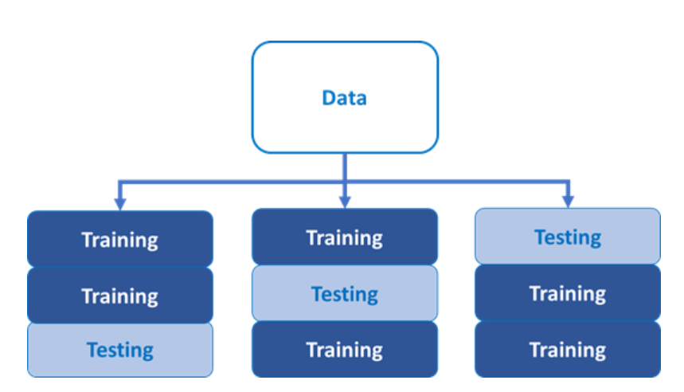
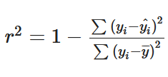
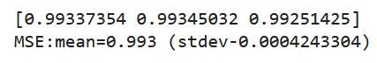
Summary of important terms
stochastic gradient descent
epochs
data split
evaluation
cross-validation

Slide 25
Content
Machine Learning – Overview and Basic Understanding
The heart of Machine Learning: Fitting a Regression
Focus: Neural Networks
Short Excursion: Dependable Machine Learning
Short Excursion: Physics - Informed Deep Learning
Hands - On 1: Simple workflow for a classification task
Hands - On 2: Linear regression from scratch
Hands - On 3: Training and evaluating a DNN

Slide 26
3. Focus: Neural Networks
Basics of Neural Networks
Mastering Model Building
Evaluation of Results
Hands - On 3: Training and evaluating a DNN

Slide 27
Basics of Neural Networks

Slide 28
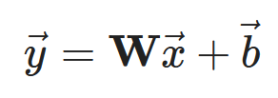
Linear mapping and displacement
input
output
output
input

Slide 29
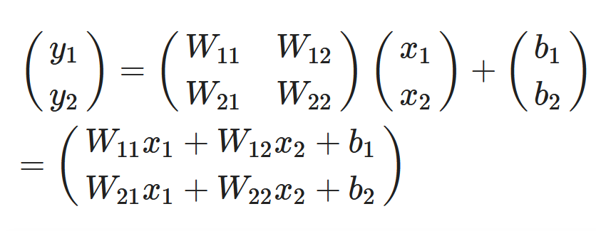
Linear mapping and displacement
input 1
node 1
input 2
node 2
output
input

Slide 30
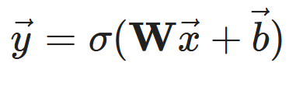
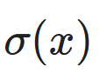
Activation
input
output
output
input
σ(y)
activation function
ReLu
sigmoid
hyperbolic tangent

Slide 31
Neural Network
input
hidden layer
output
y₁ = W₁₁x₁ + W₁₂x₂+b₁
W₁₁
x₁
σ(y₁)
c₁
W₁₂
z
z = c₁σ(y₁) + c₂σ(y₂)+d
W₂₁
c₂
W₂₂
x₂
σ(y₂)
y₂ = W₂₁x₁ + W₂₂x₂+b₂

Slide 32
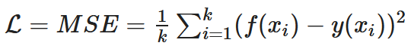
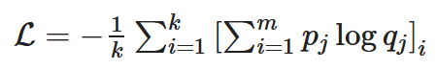
Loss function
the heart of the optimization process
Other names:
Objective function
Cost function
Regression: MSE
expected target value
network prediction with input x
Classification: cross-entropy
GOAL: Minimizing Loss

Slide 33
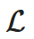

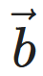
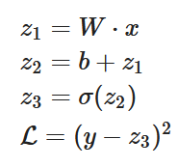
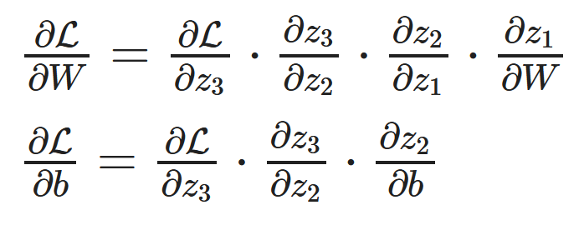
Backpropagation: Gradient descent
achieve the minimization of the loss function
Calculate partial derivates of with respect to network parameters and
z₁
z₂
z₃
x
*
+
σ
W
b
L
y
Erdmann et al., Deep learning in physics, 2021

Slide 34
Mastering model building

Slide 35
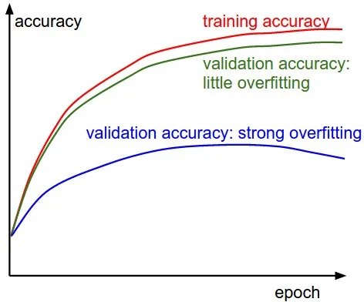
Monitoring: Validation Curves

Slide 36
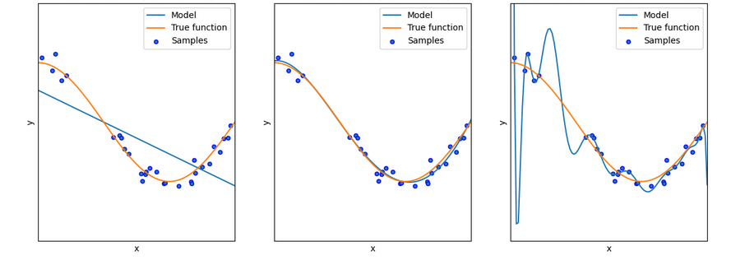
Underfitting/Overfitting

Slide 37
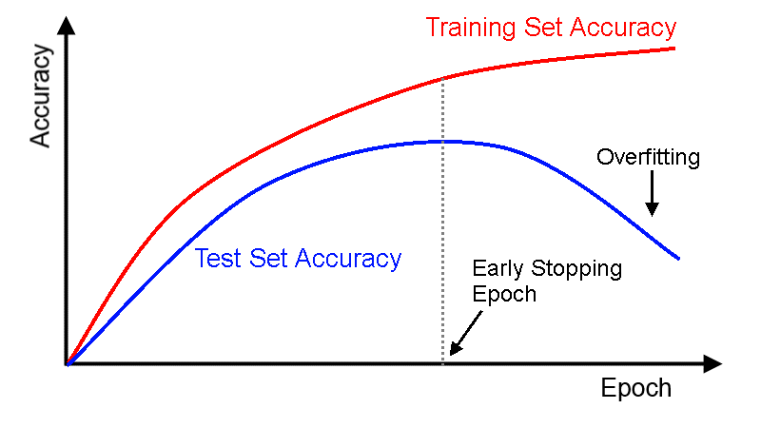
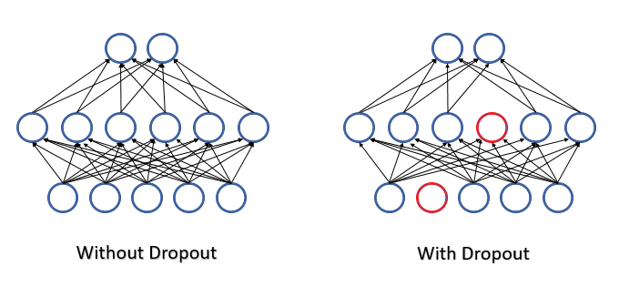
Reducing Overfitting: Regularization
„Regularization is any modification we make to a learning algorithm that is intended to reduce its generalization error but not the training error.“ *
Methods e.g.:
Early stopping
Dropout
Parameter norm penalties
https://www.researchgate.net/publication/355020694_Deep_learning_models/figures?lo=1
https://www.mql5.com/de/articles/9112
Next slide….
*citation of Ian Goodfellow et al. in „Deep learning for physics research“, p. 58

Slide 38
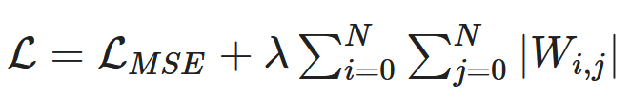
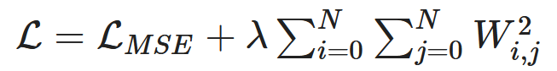
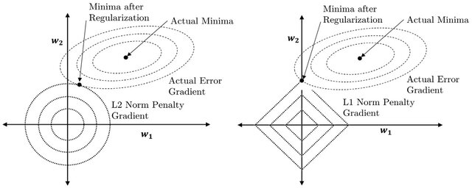
Regularization with parameter norm penelties
L1-norm penelty
L2-norm penelty
L1 term pushes W1 to zero
L2 term motivates the reduction of weights, especially the large W1 weight
https://www.researchgate.net/publication/355020694_Deep_learning_models/figures?lo=1

Slide 39
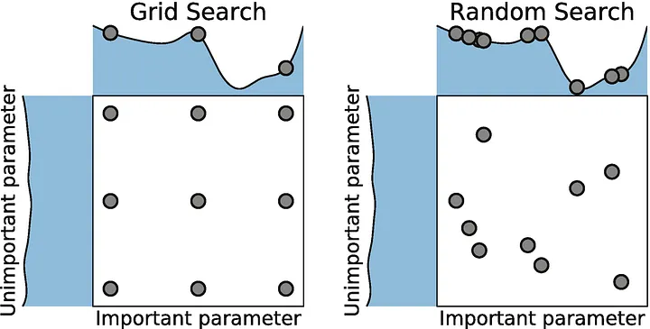
Hyperparameters and their optimization
Basic parameter: values that are derived from the learning, like node weights and bias
Hyperparameter: parameter whose value is used to control the learning process
Number of hidden layers
Number of network nodes in a layer
Choice of activation function
Initialization of network parameters
Coefficients of the regularization terms
Batch size
Learning rate
Learning strategy
Methods:
https://medium.com/@cjl2fv/an-intro-to-hyper-parameter-optimization-using-grid-search-and-random-search-d73b9834ca0a

Slide 40
CODING EXAMPLE 3: Evaluation of MNIST classifier

Slide 41
Evaluation

Slide 42
Receiver Operator Characteristics (ROC)/Area Under Curve (AUC)
ROC
AUC
ROC
True Positive Rate
AUC
False Positive Rate

Slide 43
Training, Validation, Test
Data
Training data
Test data
Validation data
fit the model
typically the largest part of the overall dataset 60-80%
estimate error of candidate models
iterative phase with training phase
measure performance of final selected model
needs to be trully blinf, i.e. test data is held out during the whole iterative training-validation phase

Slide 44
Model training,validation and test procedure
Source data
training data
validation data
test data
training
hold-out
cross-validation
bootstrapping
…
models
validation
final model
best model
testing

Slide 45
APPLICATION: Different network types for different pyhsical questions

Slide 46
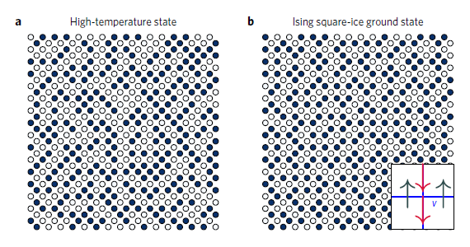
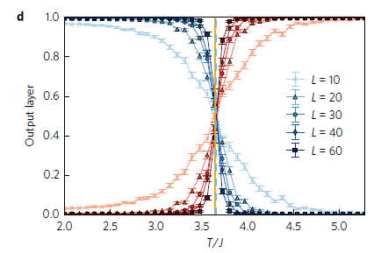
Application 1: Different networks for different physical tasks
Fully connected networks:
classical network architectures
without taking locality properties and symmetries into account
Tasks:
simple image classification
regression
E.g.:
classification of magnetic phases
High-temperature state
Ising square-ice ground state
Carrasquilla and Melko, Machine learning phases of matter, Nature Physics Letters 2017

Slide 47
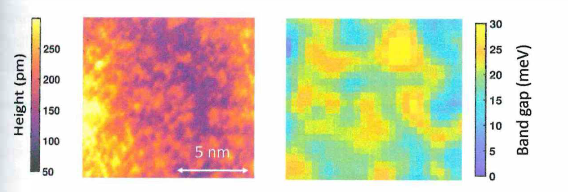
Application 2: Different models for different physical tasks
input
filters
Convolutional networks:
Sliding small filters with adaptive weights over the input
Far more efficient than fully-connected networks
Tasks:
analysis of image like data, scientific imaging
Classifiaction and regression
E.g.:
Classification: Is the detector response signal or background?
Regression: What is the energy of a measured particle?
Reconstruction tasks:
pixel-wise classification
pixel-wise regression: pixel-wise prediction of the local densities of states from a topograph
feature maps
topographic image
band gap
Erdmann et al., Deep learning for physics research, World Scientific, 2021

Slide 48
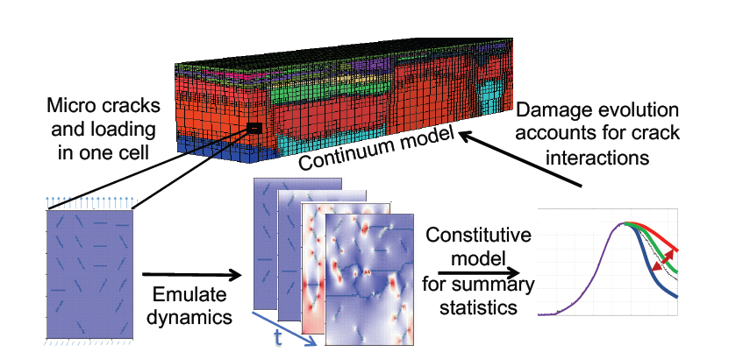
Application 3 : Different models for different physical tasks
Recurrent neural networks:
elementary networks for processing sequential data
alternative to feedword networks that takes into account already stored elements when processing new ones
additional memory called internal state
Tasks:
Nonlinear time series
Outlier detection
Nonlinear dynamics
E.g.:
physics-informed spatio-temporal approach for crack growth and propagation: track time evolution of stress and damage in a simulated material
y_{t}
h_{t-1}
h_{t}
x_{t}
Mehta et al., Physics-Informed Spatiotemporal Deep Learning for Emulating Coupled Dynamical Systems. In AAAI Spring Symposium: MLPS 2020

Slide 49
Content
Machine Learning – Overview and Basic Understanding
The heart of Machine Learning: Fitting a Regression
Focus: Neural Networks
Short Excursion: Dependable Machine Learning
Short Excursion: Physics - Informed Deep Learning
Hands - On 1: Simple workflow for a classification task
Hands - On 2: Linear regression from scratch
Hands - On 3: Training and evaluating a DNN

Slide 50
Content
4. Short Excursion: Dependable Machine Learning

Slide 51
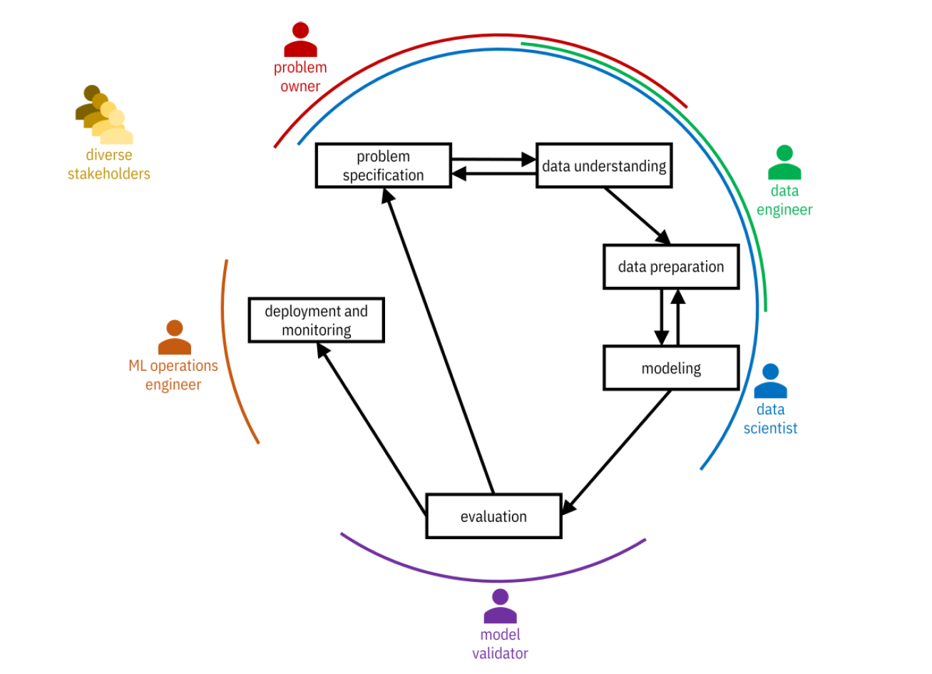
Dependable machine learning: overview

Slide 52
Dependable machine learning: overview
physicist
material scientist
…

Slide 53
Dependable Machine Learning
ML lifecycle elements
specification
data handling
model building
evaluation/
validation
testing
deployment
ML dependability elements
robustness
generalizability
explainability
uncertainty quantification

Slide 54
specification
data handling
model building
evaluation/
validation
testing
deployment
…
…
…
…
training data augmentation
test data augmentation
robustness
…
…
bias, variance, confusion matrix…
drift detection
…
regularization
generalizability
…
…
feature importance
…
…
…
explainability
surrogate models
…
…
…
uncertainty quantification
Bayesian methods
Ensemble methods
calibration error

Slide 55
specification
data handling
model building
evaluation/
validation
testing
deployment
…
…
…
…
training data augmentation
test data augmentation
robustness
…
…
bias, variance, confusion matrix…
drift detection
…
regularization
generalizability
…
…
feature importance
…
…
…
explainability
surrogate models
…
…
…
uncertainty quantification
Bayesian methods
Ensemle methods
calibration error

Slide 56



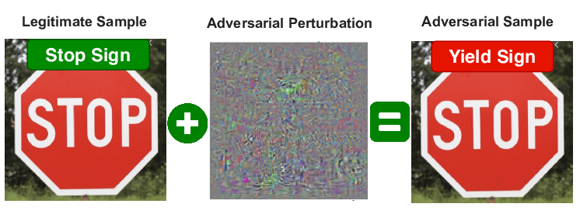

Robustness

Slide 57
Robustness
In general, robustness is an attribute that aims to examine the extent to which a learning algorithm produces acceptable results when subjected to exceptional or corrupted data.

Slide 58
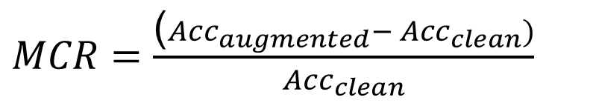
Robustness assessment
Robustness metric:
$MCR=\frac{\text{(}{Acc}_{augmented}− {Acc}_{clean})}{{Acc}_{clean}}$
misclassification
Siedel, Vock, Morozov, Voß: Utilizing Class Separation Distance for the Evaluation of Corruption Robustness of Machine Learning Classifiers, IJCAI_ECAI 2022 eingereicht

Slide 59
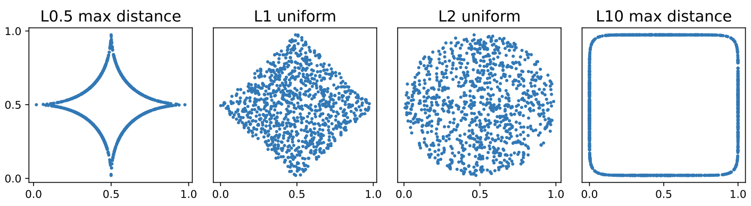
Core Concept – Random Lp-norm Corruptions
Largest possible coverage of pixelwise noise
Combination of various Lp-norms for noise injection

Slide 60
ε
2r
Class 1
Class 2
[Yang et al.: „A Closer Look at Accuracy vs. Robustness”, 2020]
Input Parameter 2
Input Parameter 1

Slide 61
εmin
2r
Class 1
Class 2
[Yang et al.: „A Closer Look at Accuracy vs. Robustness”, 2020]
Input Parameter 2
εmin = r
Input Parameter 1

Slide 62
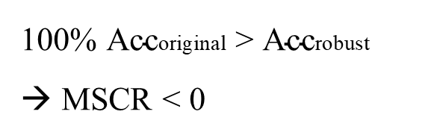
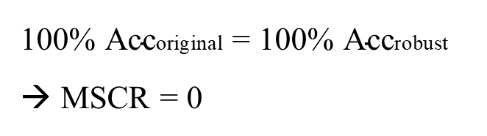
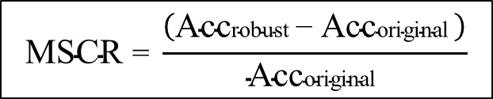
εmin
2r
MSCR… Minimal Separation Corruption Robustness
$$\text{MSCR} \text{= }\frac{\left(\text{Acc}\text{robust} \text{− }\text{Acc}\text{original} \right)}{\text{Acc}\text{original} }$$
Input Parameter 2
100% $\text{Acc}\text{original}$ > $\text{Acc}\text{robust}$
→ MSCR < 0
100% $\text{Acc}\text{original}$ = 100% $\text{Acc}\text{robust}$
→ MSCR = 0
Input Parameter 1

Slide 63
Accuracy-Robustness-Tradeoff?
Optimum

Slide 64
specification
data handling
model building
evaluation/
validation
testing
deployment
…
…
…
…
training data augmentation
test data augmentation
robustness
…
…
bias, variance, confusion matrix…
drift detection
…
regularization
generalizability
…
…
feature importance
…
…
…
explainability
surrogate models
…
…
…
uncertainty quantification
Bayesian methods
Ensemle methods
calibration error

Slide 65
specification
data handling
model building
evaluation/
validation
testing
deployment
…
…
…
…
training data augmentation
test data augmentation
robustness
…
…
bias, variance, confusion matrix…
drift detection
…
regularization
generalizability
…
…
feature importance
…
…
…
explainability
surrogate models
…
…
…
uncertainty quantification
Bayesian methods
Ensemle methods
calibration error

Slide 66
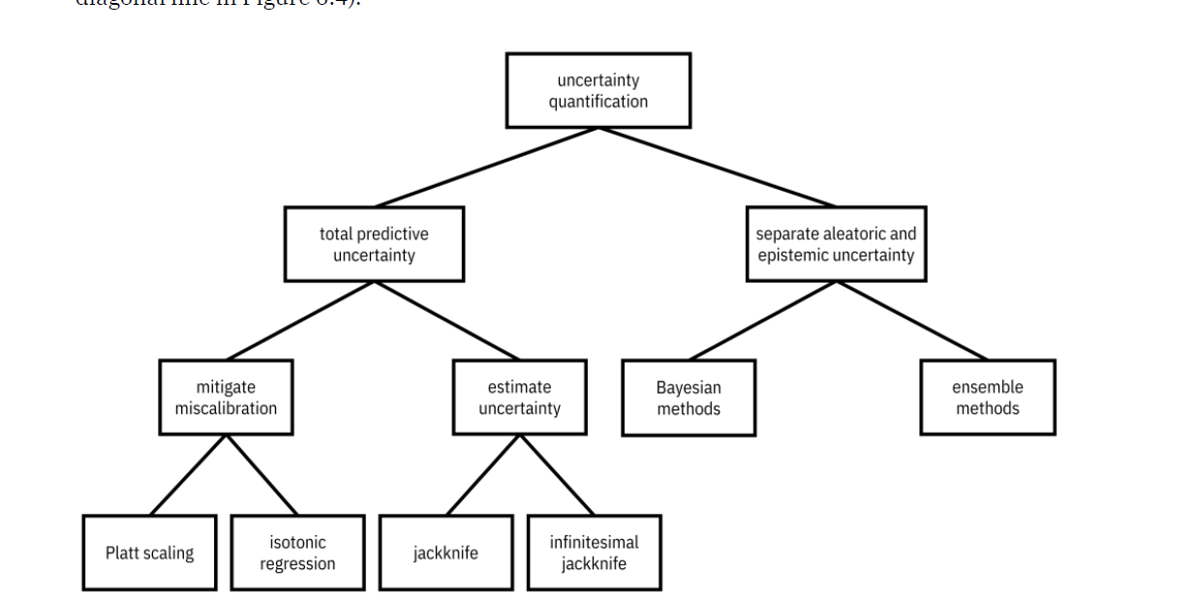
Uncertainty Quantification
Bagging + Boosting

Slide 67
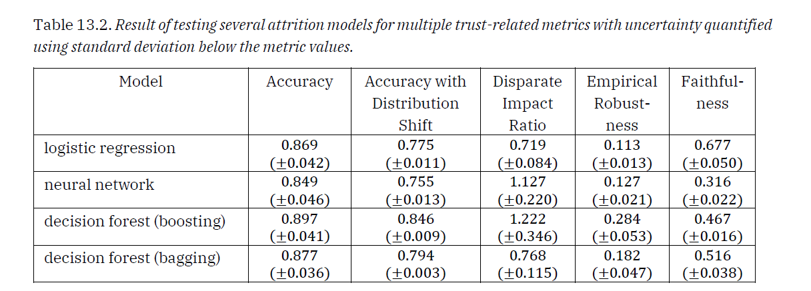
Uncertainty quantification

Slide 68
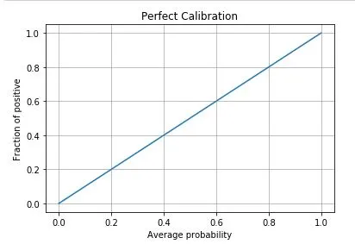
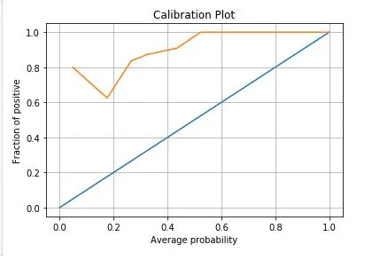


Calibration
In calibration we try to improve our model such that the distribution and behavior of the probability predicted is similar to the distribution and behavior of probability observed in training data
https://medium.com/analytics-vidhya/calibration-in-machine-learning-e7972ac93555

Slide 69
Content
Machine Learning – Overview and Basic Understanding
The heart of Machine Learning: Fitting a Regression
Focus: Neural Networks
Short Excursion: Dependable Machine Learning
Short Excursion: Physics - Informed Deep Learning
Hands - On 1: Simple workflow for a classification task
Hands - On 2: Linear regression from scratch
Hands - On 3: Training and evaluating a DNN

Slide 70
Content
5. Short Excursion: Physics - Informed Deep Learning

Slide 71

Physics-based deep learning
https://physicsbaseddeeplearning.org/overview.html

Slide 72
Categories of physics-based deep learning
Supervised: the data is produced by a physical system (real or simulated), but no further interaction exists. This is the classic machine learning approach.
Loss-terms: the physical dynamics (or parts thereof) are encoded in the loss function, typically in the form of differentiable operations. The learning process can repeatedly evaluate the loss, and usually receives gradients from a PDE-based formulation. These soft constraints sometimes also go under the name “physics-informed” training.
Interleaved: the full physical simulation is interleaved and combined with an output from a deep neural network; this requires a fully differentiable simulator and represents the tightest coupling between the physical system and the learning process. Interleaved differentiable physics approaches are especially important for temporal evolutions, where they can yield an estimate of the future behavior of the dynamics.
https://physicsbaseddeeplearning.org/overview.html

Slide 73

Supervised with „perfect“ data
Example: projectile motion (in free-fall)
https://towardsdatascience.com/physics-informed-neural-networks-pinns-an-intuitive-guide-fff138069563

Slide 74

Realistic scenario: noisy, sparse and incomplete data
Example: projectile motion
https://towardsdatascience.com/physics-informed-neural-networks-pinns-an-intuitive-guide-fff138069563

Slide 75





Modifying the loss-term with physical laws

Slide 76
Content
Machine Learning – Overview and Basic Understanding
The heart of Machine Learning: Fitting a Regression
Focus: Neural Networks
Short Excursion: Dependable Machine Learning
Short Excursion: Physics - Informed Deep Learning
Hands - On 1: Simple workflow for a classification task
Hands - On 2: Linear regression from scratch
Hands - On 3: Training and evaluating a DNN

Slide 77
Summary
Overview on machine learning
Basic elements of neural networks
Basic steps of a data driven evaluation
Dependability aspects
Getting physics into machine learning algorithms

Slide 78








AI Team in Dresden
Challenge:
Risk assessment of machines with AI in safety-relevant functions
AI team since 2022 in Dresden
AI-Team Dresden
S.Vock
materials scientist
team leader
Weija Shao
PostDoc
informatics
from Oct. 2023
M. Alipour
PostDoc
mathematician
parental leave
S. Musavishavazi
PhD student
mathematician
since september 2022
S. Jacob
PhD student
mathematician
since April 2023
F. Wolny
physicist
since January 2023
G.Siedel
Mechanical engineer
PhD student
since 2021

Slide 79











Helpful tools
Google colab

Slide 80
References and reading suggestions
monographs
Thomas Nield | Essential Math for Data Science | O‘Reilly | 2022 | intro + python intro
Kush Varshney | Trustworthy Machine Learning |  | 2022 | overview of methods for dependability and trustw.
Erdmann et al. | Deep Learning in Physics Research | World Scientific Publishing | 2021 | Intro + special physics examples
Raschka and Mirjalili | Python Machine Learning | Packt> | 2019 | comprehensive intro + advanced topics
Huang et al. | Machine Learning Safety | Springer | 2023 | Overview topics for safe/trustworth./dependable ML

Slide 81
References and reading suggestions
websites
https://towardsdatascience.com/physics-informed-neural-networks-pinns-an-intuitive-guide-fff138069563
→ short intro
https://deeplearningforphysicsresearchbook.github.io/deep-learning-physics/
→ comprehensive intro to ML and examples in physics + excercises and solutions in python
https://physicsbaseddeeplearning.org/intro.html
→ Comprehensive and advanced intro to deep learning in context of physical simulations

